Slide 1
Circular Doubly Linked List
DSA LAB 8
BCSF18 Morning/Afternoon
Mariha Asad

Slide 2
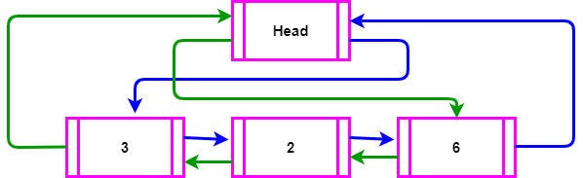
Introduction
Reference to previous node
Reference to next node

Slide 3

Introduction
When no data in the doubly linked list

Slide 4

Insert first Element

Slide 5
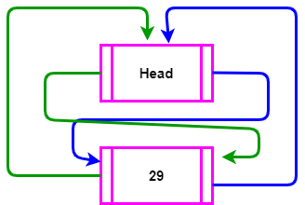
Insert first Element

Slide 6
Insert in Start

Slide 7
Insert in Start
Step # 1
Dnode *temp = new Dnode;
Step # 2
temp data = val;
Step # 3
temp next = head.next;
temp prev = &head;

Slide 8
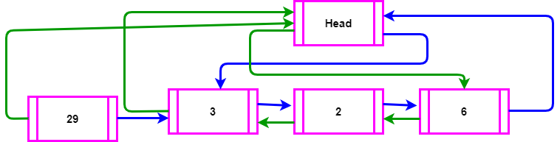
Insert in Start

Slide 9
Insert in Start
Step # 4
head.next prev = temp;
Step # 5
head.next = temp;

Slide 10
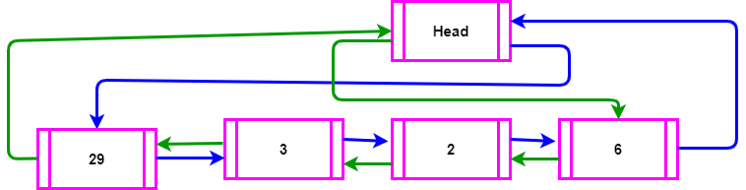
Insert in Start

Slide 11
Sorted Insert
Make a new node temp
Let current node is point to head.next in order to traverse linked list
Current = current next;
What is the condition of loop???
1- current != &head
2- current data < val

Slide 12
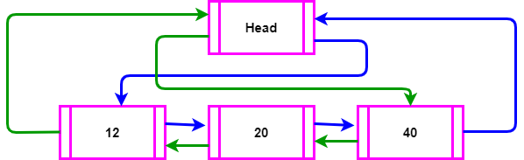
Sorted Insert
temp

Slide 13
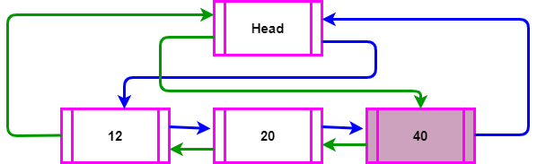
Sorted Insert

Slide 14
Sorted Insert
temp next = current;
temp prev = current prev;
current prev next = temp;
current prev = temp;

Slide 15
Thank you Any Questions???

Slide 16
Lab Question
1 2 3 4 5 | Circular singly linked list
1 3 5 | 2,4 eliminate
3 | 1,5 eliminate
Remaining in the linked list

